Slide 1

Hello!

Slide 2
The frogs of the Amazon rainforest
SEGRETIER Thaïs and ERIAU Raphaëlle

Slide 3
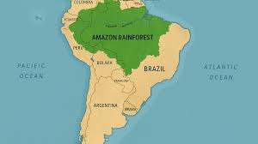
Introduction
In South America .
One of the largest forest .
Thousands of species coexist ( amphibians...) .
The frogs are important to the ecosystem .

Slide 4
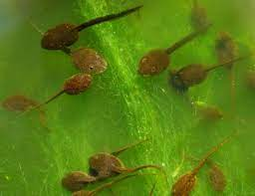
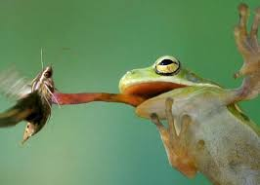
Lifespan
Food
5 to 10 years.
Tadpoles: algae.
Adult frogs : insects.

Slide 5
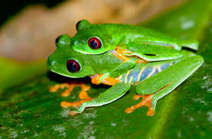
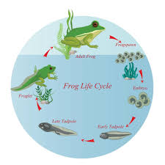
Reproduction
The male sings.
The female lays eggs in water or on wet leaves.
Eggs > Tadpoles > Adult frogs.

Slide 6
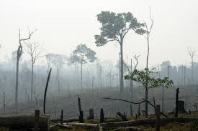
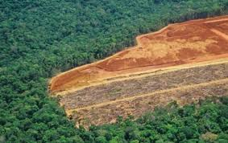
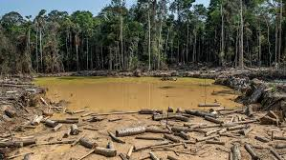
The dangers and threats
Deforestation
Pollution
Animal trafficking
Climate change

Slide 7
The different species
More than 1000 species of frogs in the Amazon rainforest.

Slide 8
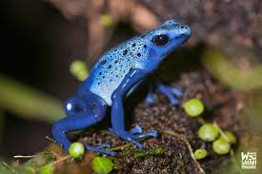
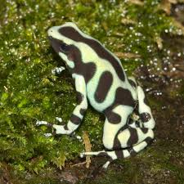
The Dendrobates
55 different species

Slide 9
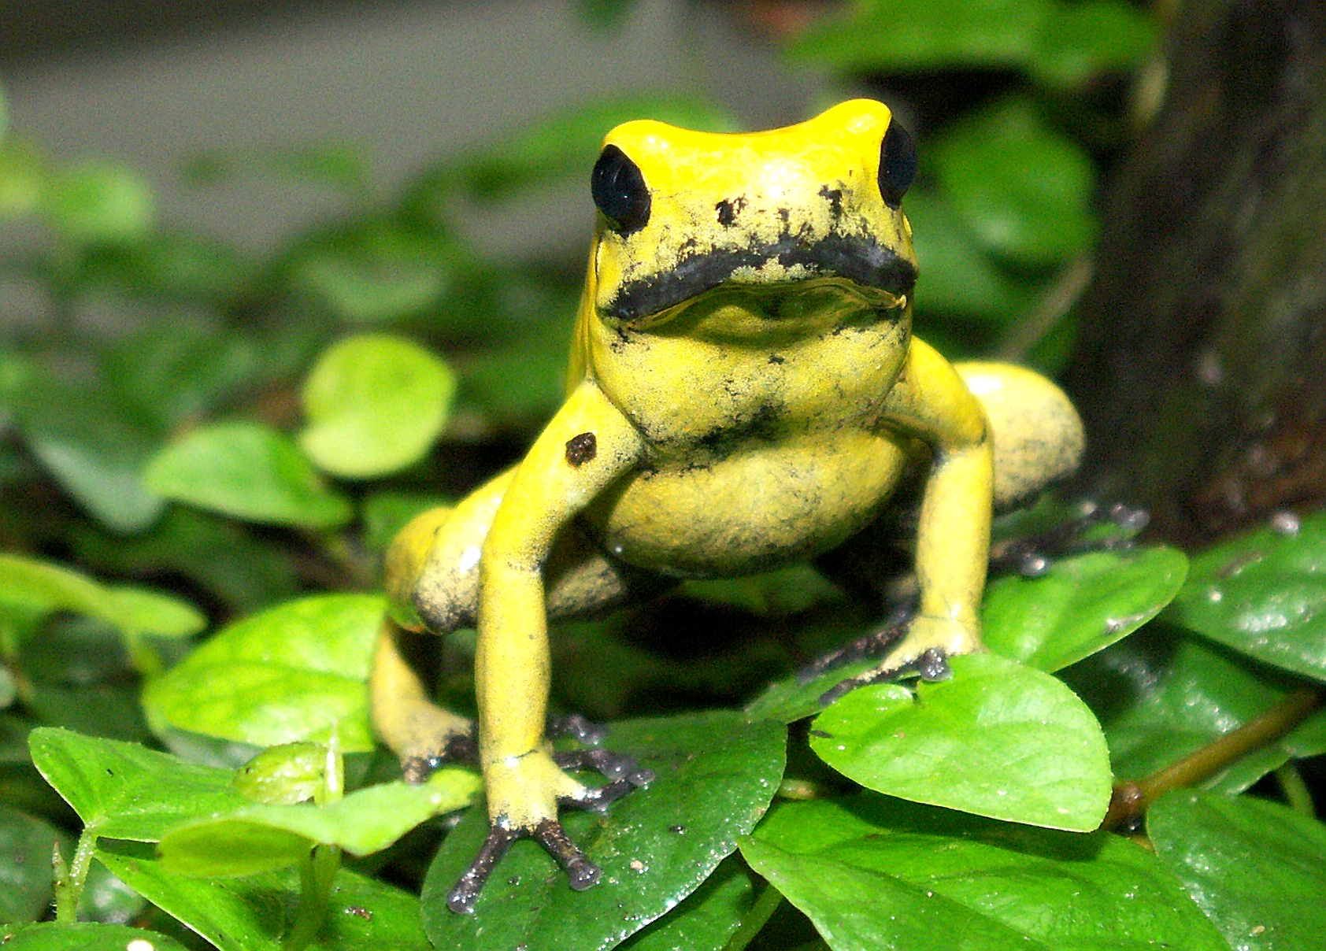
The Phyllobates terriblis
One of the most venomous.

Slide 10
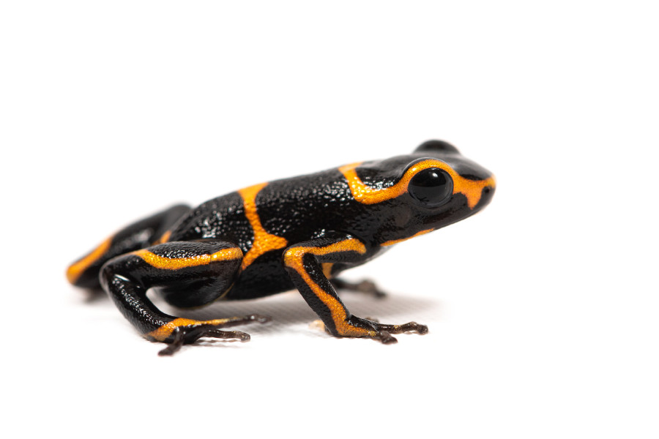
The Ranitomeya imitator
Small orange and black frog.

Slide 11
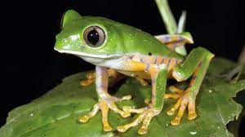
The Drendroprophus minutus
Very common, small and very vocal frog.

Slide 12

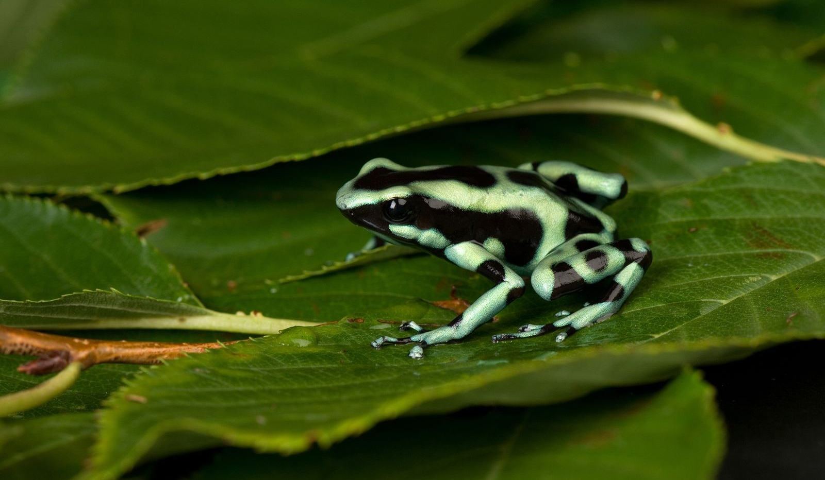
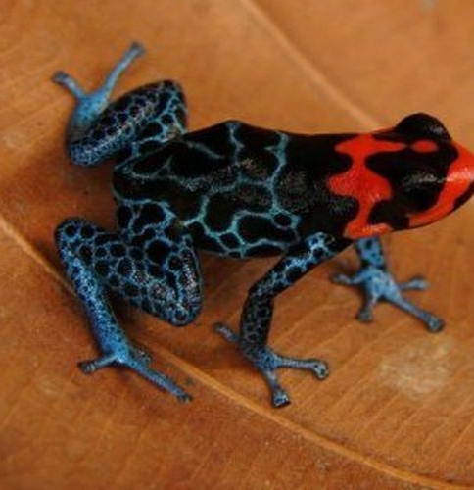
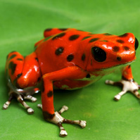
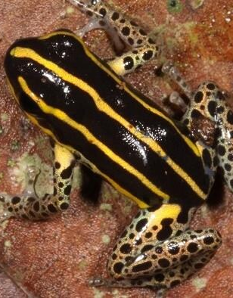
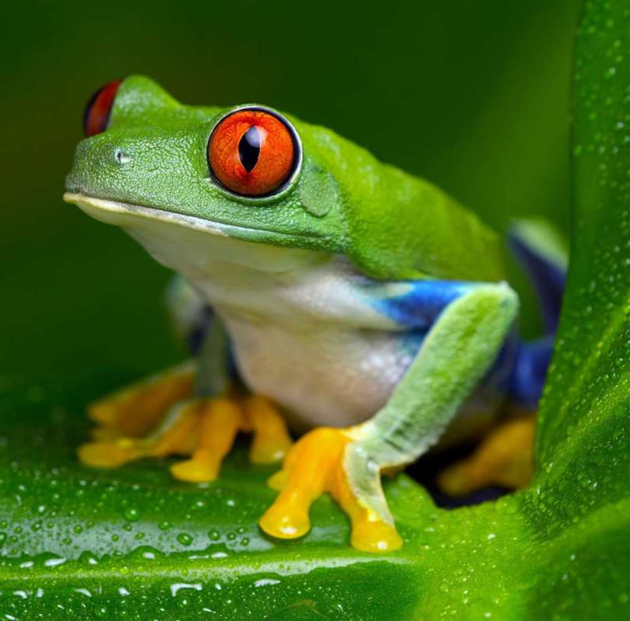
And many others

Slide 13

Conclusion
Frogs are important for the biodiversity of the Amazon rainforest.
SO PROTECT THE FROGS!!!

