Slide 1
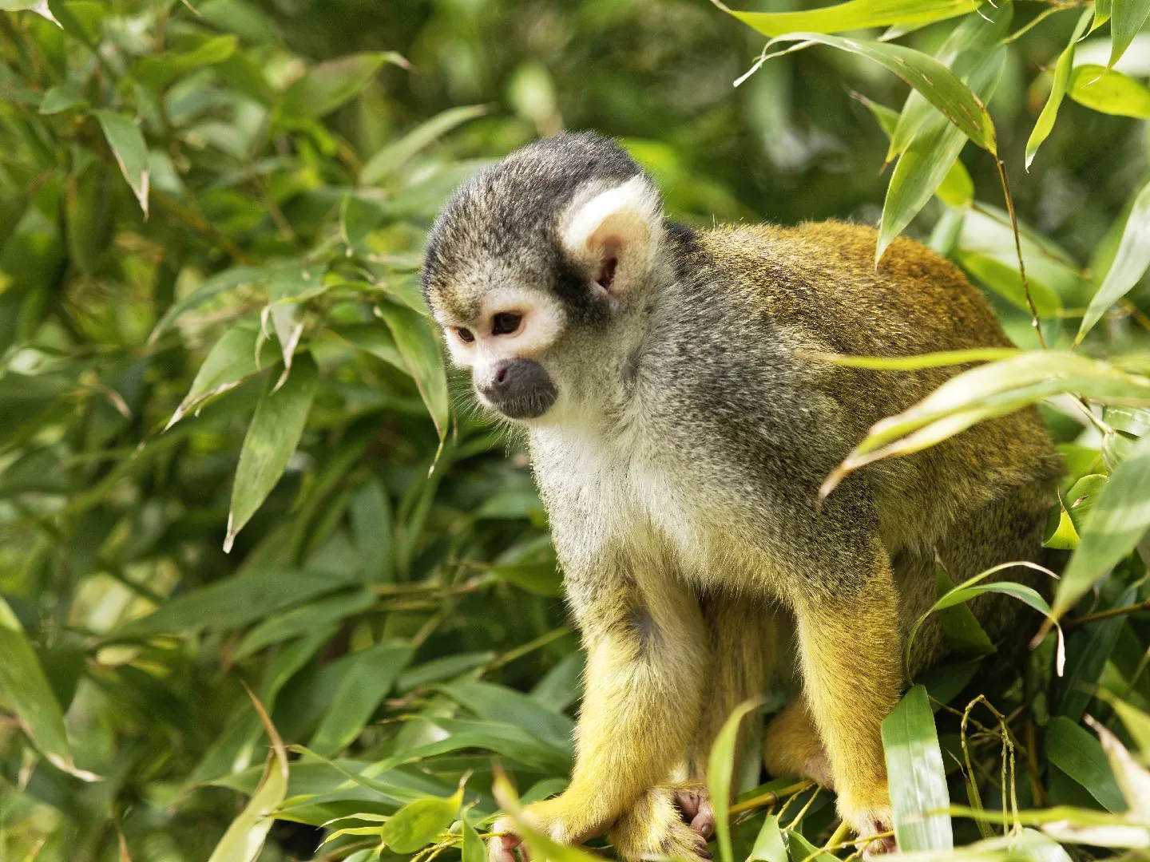
The squirel monkey:the saimiri
by Oscar and Jules

Slide 2
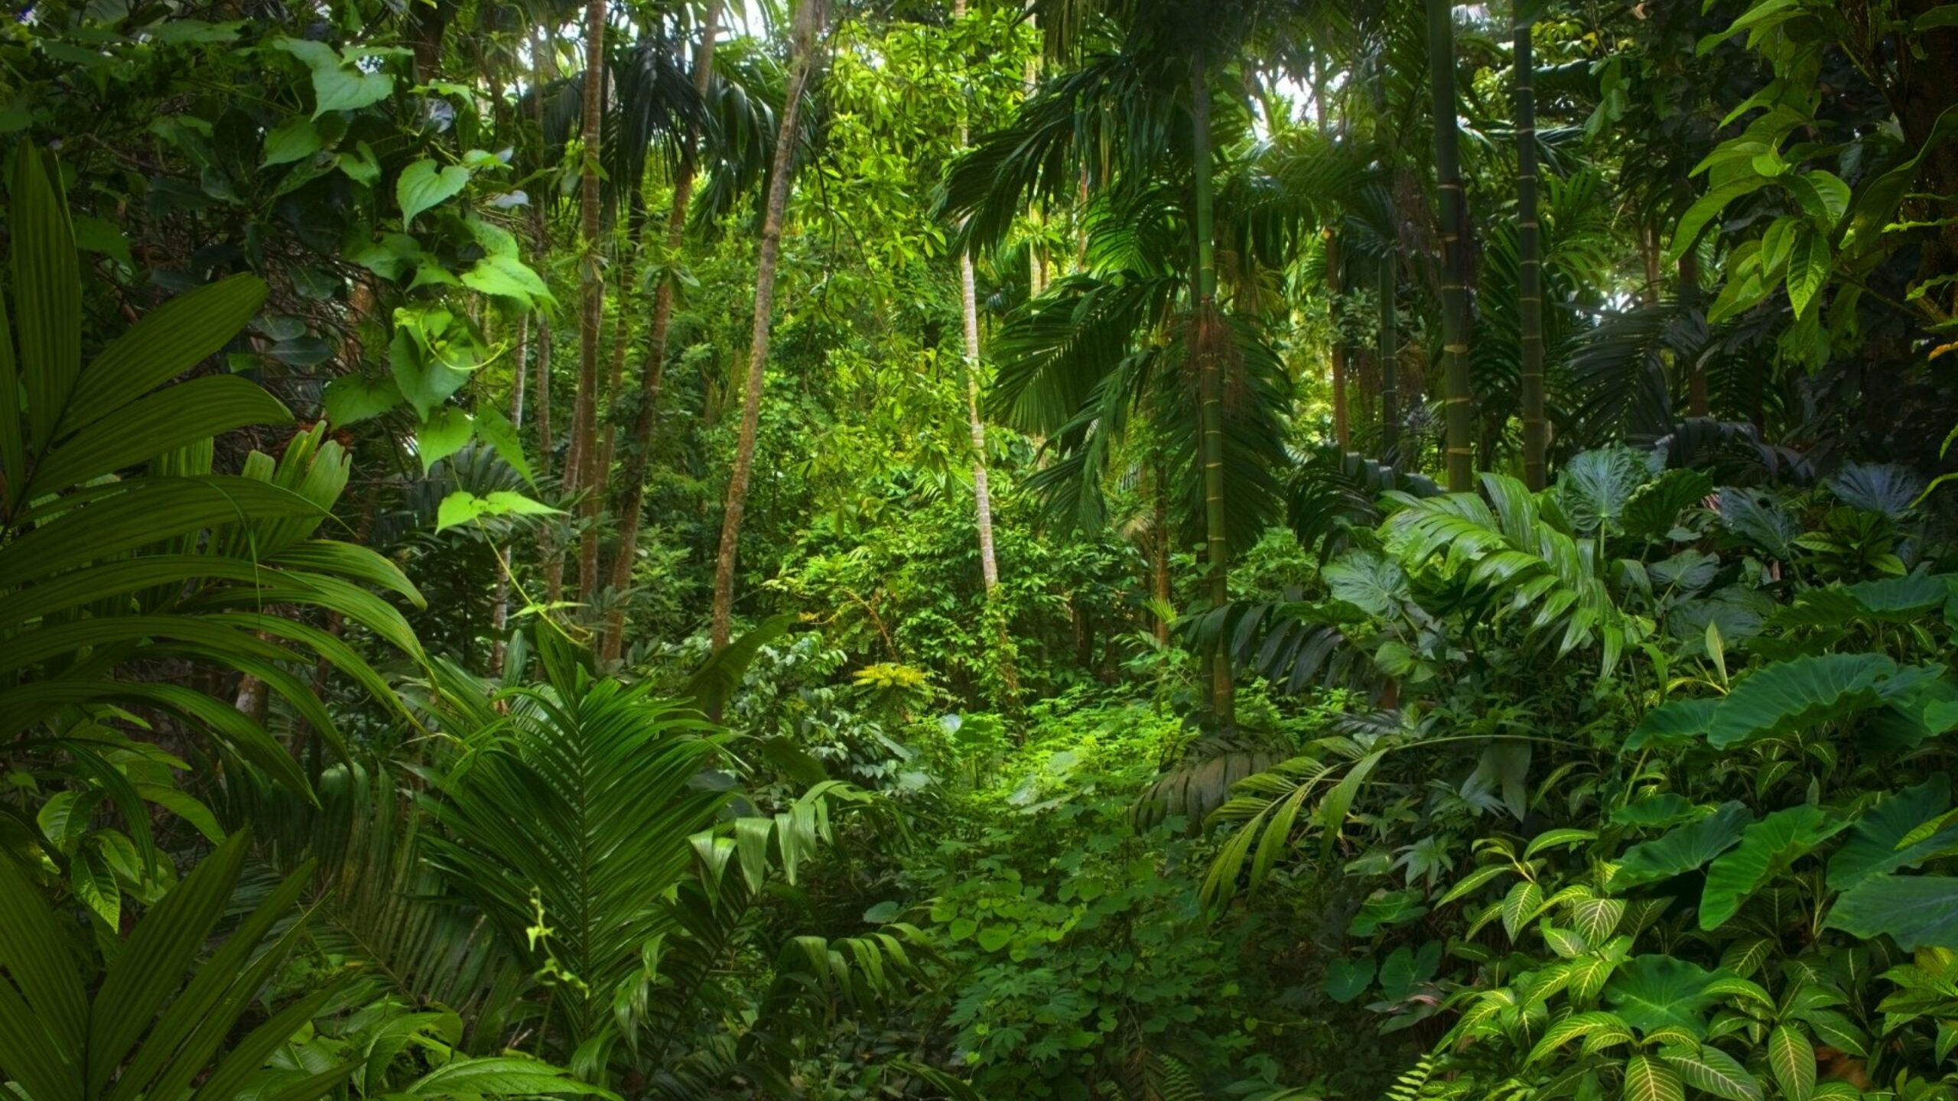
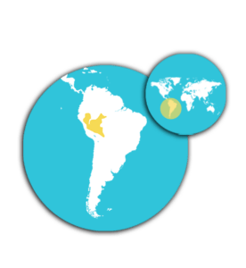
introduction
The Peruvian saimiri, nicknamed the squirrel monkey, lives in South America, in the large rainforests of the Amazon, often along rivers and even some of which are prone to flooding.

Slide 3
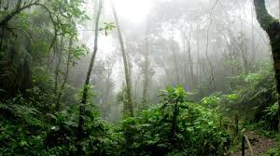
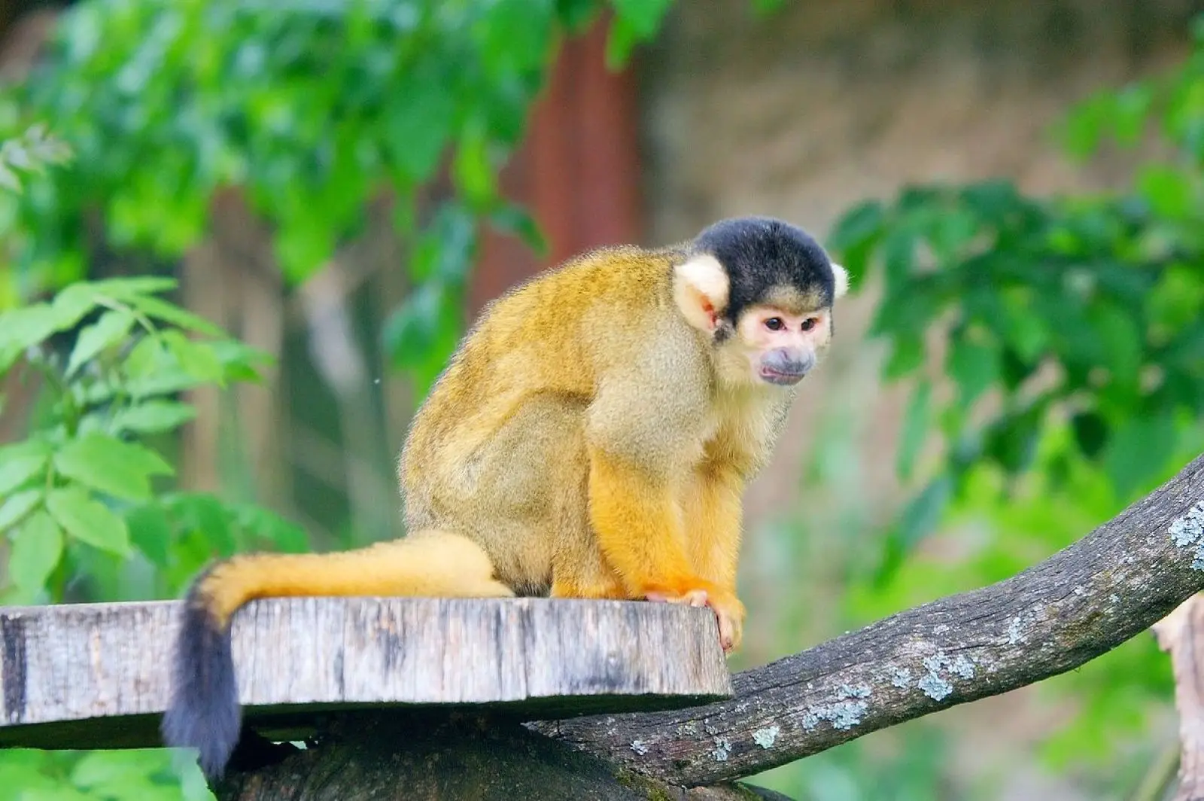
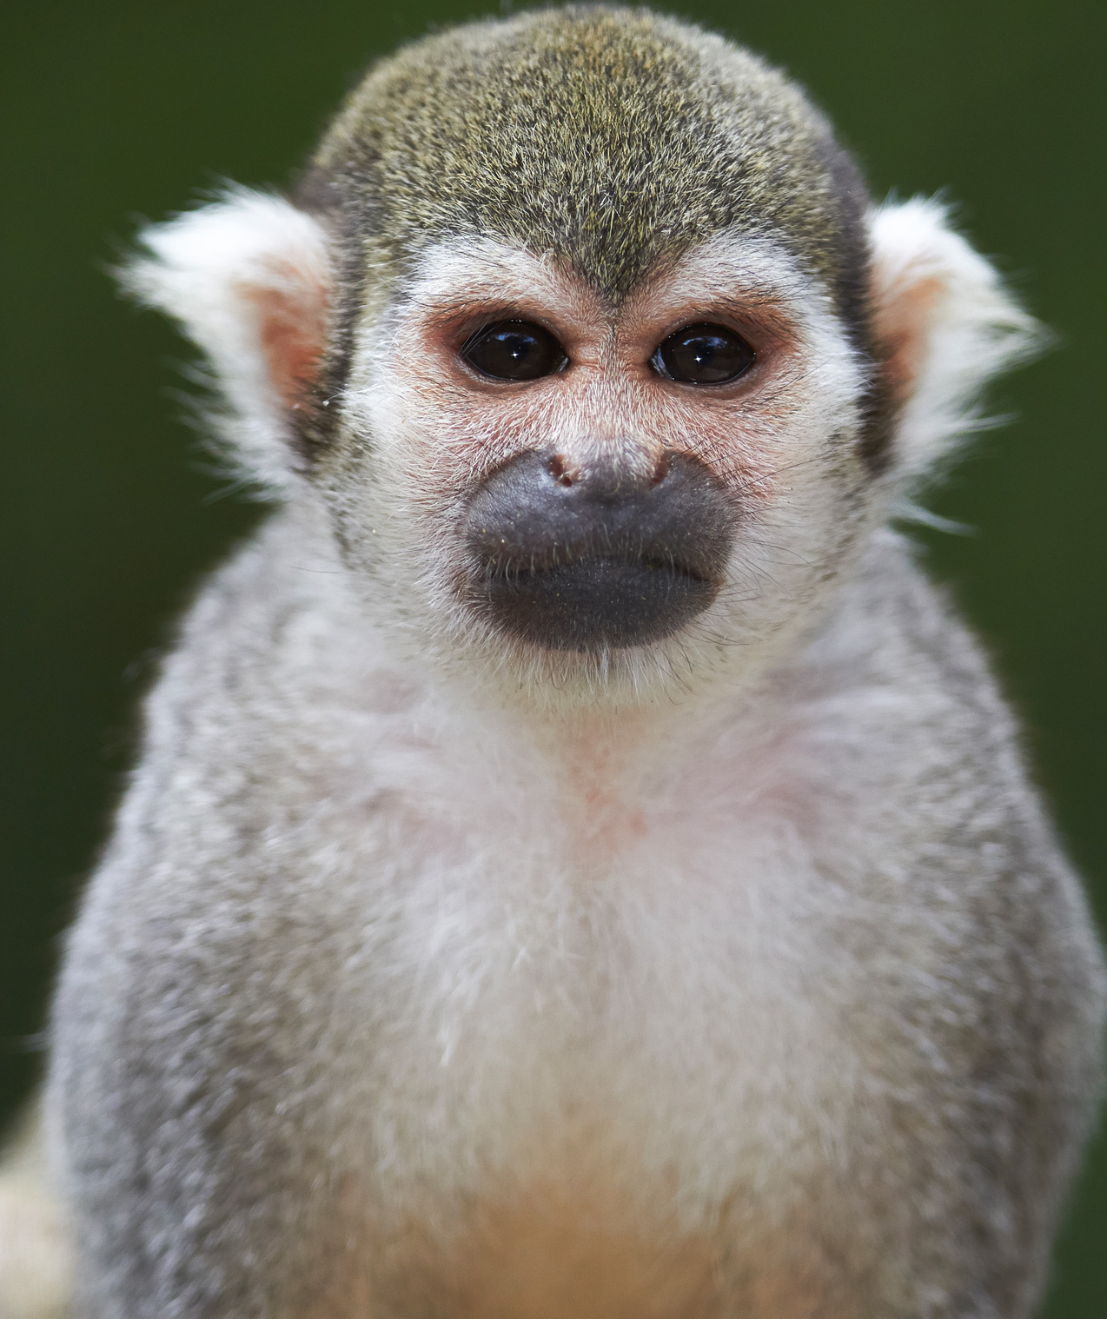
Physical Characteristics
The saimiri has a white mask which has sometimes earned it the name of death's head monkey.
It is a small tree monkey from South America. Recognizable easily by the olive yellow color of its fur

Slide 4
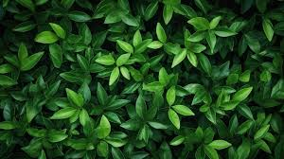


A male individual is between 25 and 27 cm long and can weigh 550g to 1.2kg
It lives up to 20 years in the wild, and up to 30 years in captivity.
20 years in the wild, and up to Females less corpulent measures between 22 and 30 cm for a weight that varies between 365 and 750g. It lives up to 30 years in captivity like the male
Weight and longevity

Slide 5


Diet
The Saïmiri of Peru are omnivorous and the diet consists mainly of fruits and insects they can supplement this diet with nuts, berries, flowers, seeds, leaves, eggs, but also small vertebra such as bats or birds. Squirrels have an insectivorous and herbivorous diet.

Slide 6
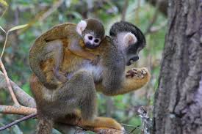
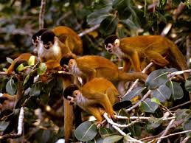
The breeding season of the Squirrel varies according to the region, but it is often reasonable, coinciding with the most fertile periods in fruit. The reproductive period is synchronized in females and lasts 3 months after a gestation of 5 to 6 months, which is relatively long, the small nose well formed and relate initially by the sea and then by two non-pregnant females
Squirrels live in groups of 20 to 60 individuals. Some groups may even consist of more than 300 animals.
Population and reproduction

Slide 7
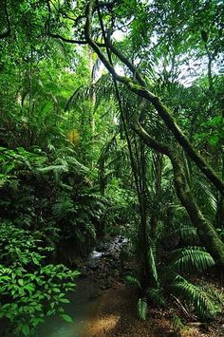
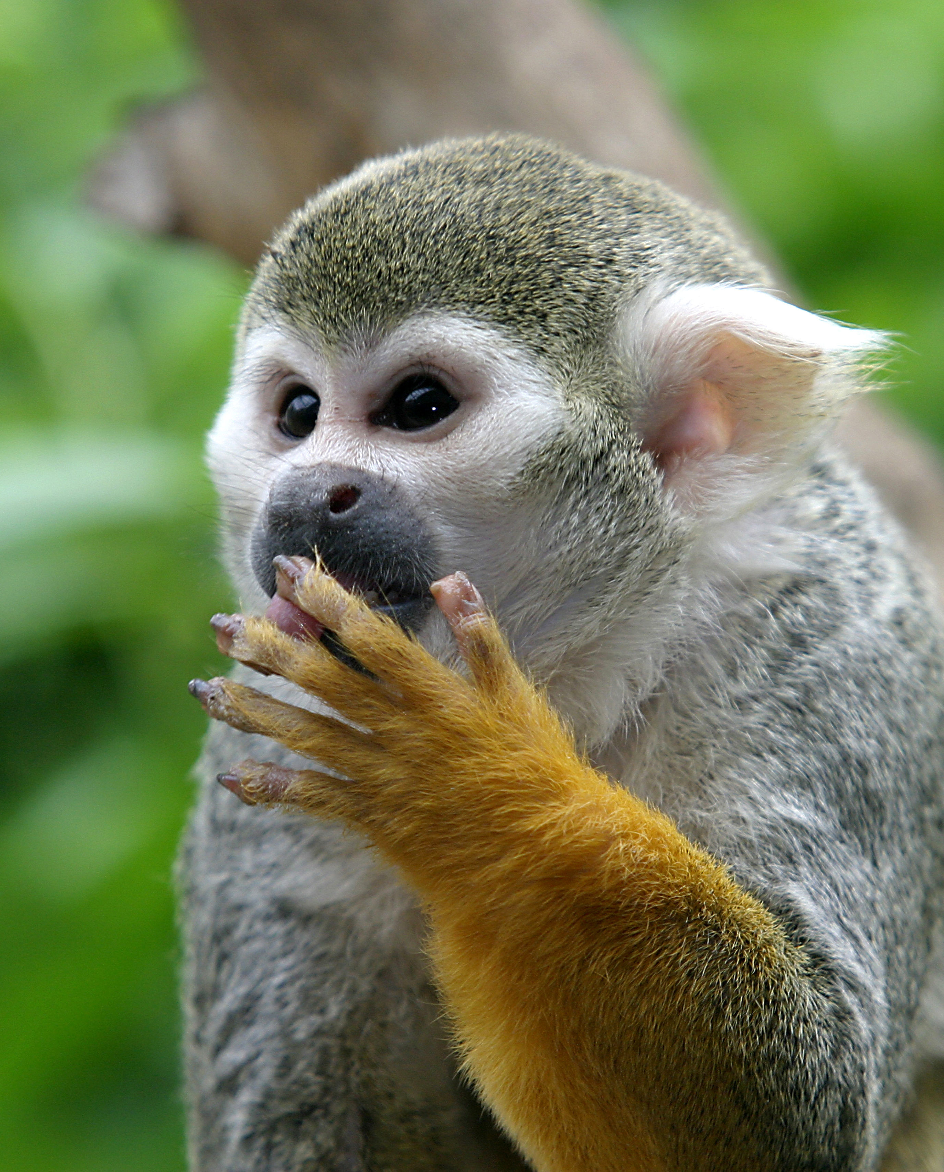
Thank you for listening us.

Slide 8
Words bank:
allongé sur le ventre en position allongée. Lying on her stomach.
Prone:
Earned:
_{Rapporter: earning capacity}
Vertebra:
Vertebre.
Seeds:
Des graines ou une semence
Breeding season:
La saison des amours.
Non-pregnant females:
une femme qui n'est pas enceinte.

